Slide 1
Visual Analytics Sandbox
Satya Katragadda
January 25, 2018

Slide 2
Agenda
Why Big Data?
Goals
Visual Analytics Sandbox
Traditional Workflow in a Big Data Environment
VA Sandbox: Software Stack
VA Sandbox: Execution Examples

Slide 3
Why Big Data?
Reports, e.g.,
Track business processes, transactions
Diagnosis, e.g.,
Why is user engagement dropping?
Why is the system slow?
Detect spam, worms, viruses, DDoS attacks
Decisions, e.g.,
Decide what feature to add
Decide what ad to show
Block worms, viruses, …

Slide 4
Goals
Low latency (interactive) queries on historical data: enable faster decisions
E.g., identify why a site is slow and fix it
Low latency queries on live data (streaming): enable decisions on real-time data
E.g., detect & block worms in real-time (a worm may infect 1mil hosts in 1.3sec)
Sophisticated data processing: enable “better” decisions
E.g., anomaly detection, trend analysis

Slide 5
Visual Analytics Sandbox

Slide 6
Big Data Workflow
Data Ingestion
Data Management
Data Processing
Visualization
Resource Management

Slide 7
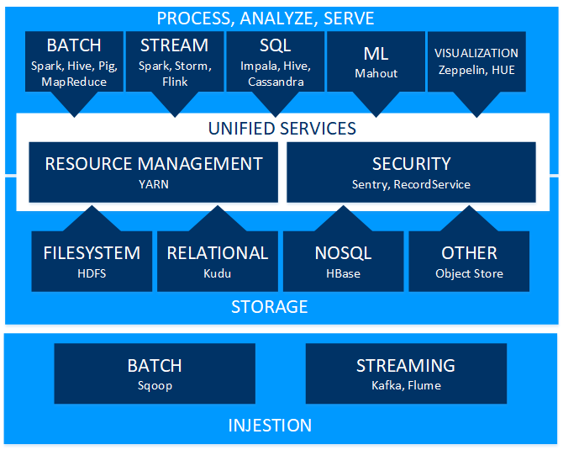
VA Sandbox: Software Stack

Slide 8
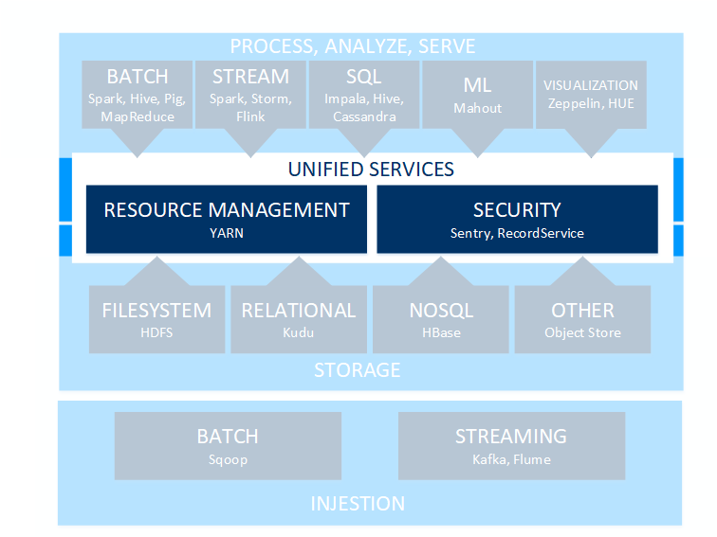
VA Sandbox: Resource Manager

Slide 9
VA Sandbox: Data Injestion

Slide 10
VA Sandbox: Data Storage

Slide 11
VA Sandbox: Processing and Visualization

Slide 12
VA Sandbox
Stephens Hall
Accessible through university network

Slide 13
VA Sandbox: Access

Slide 14
VA Sandbox: Execution

Slide 15
VA Sandbox: Input

Slide 16
VA Sandbox: Spark Script

Slide 17
VA Sandbox: Spark Output

Slide 18
Alternative Execution Environment
HUE: Hadoop User Experience
An open-source Web interface that supports Apache Hadoop and its ecosystem
Component | Applications
Editor | SQL, Pig, Spark
Browsers | YARN, Oozie, Impala, HBase, Livy
Scheduler | Oozie
Dashboard | Solr, SQL (Impala, Hive...)

Slide 19
HUE: File Browser

Slide 20
HUE: Job Execution

Slide 21
HUE: Output

Slide 22
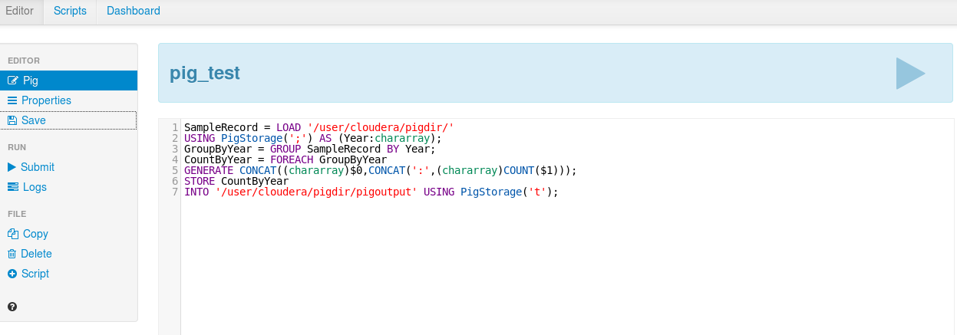
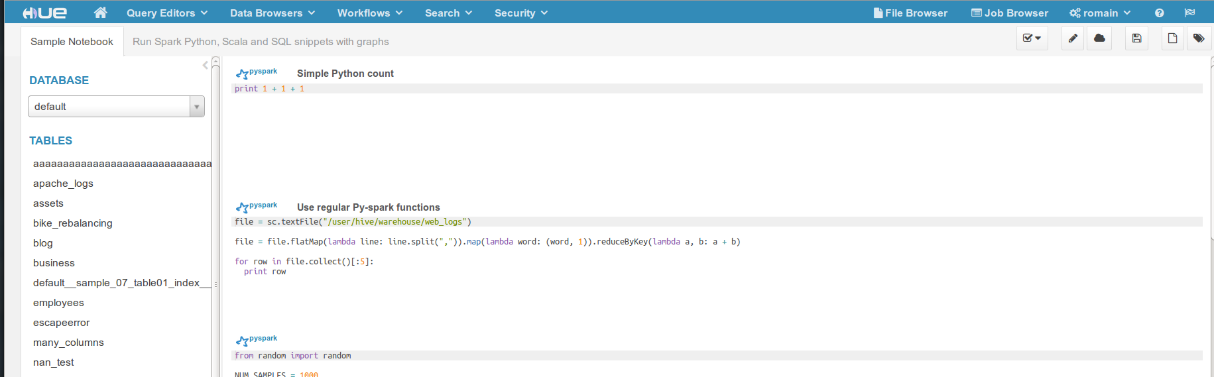
HUE: Editors

Slide 23
HUE: Schedulers

Slide 24
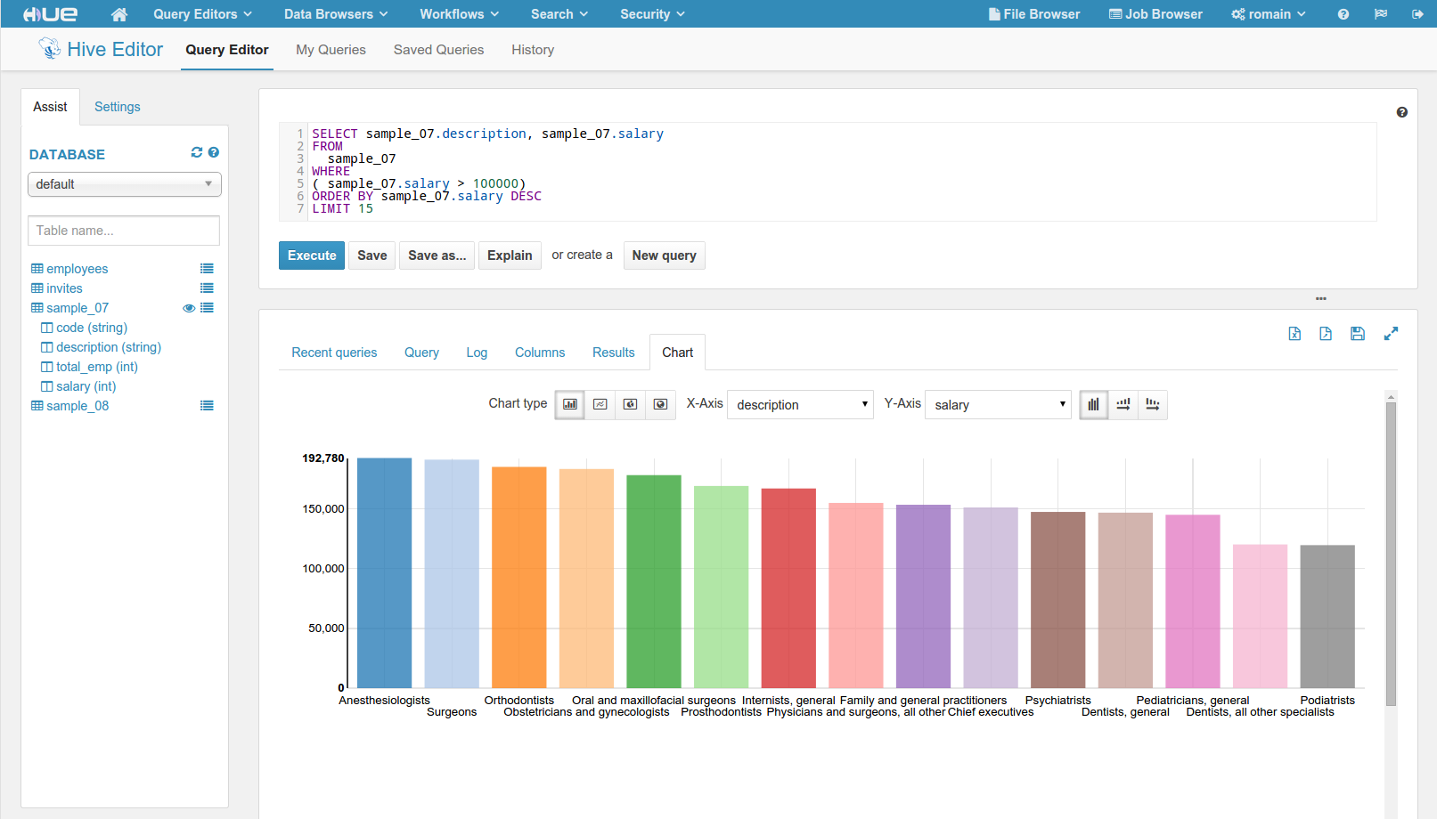
HUE: Dashboards

Slide 25
Questions?
Satya Katragadda
RM 118, Abdalla Hall
satya@Louisiana.edu

