Slide 1
Introduction to Spark

Slide 2
MapReduce enables big data analytics using large, unreliable clusters
There are multiple implementation of MapReduce
- Based on HDFS
- Based on No-SQL databases
- Based on cloud

Slide 3
Can not support Complex/iterative applications efficiently
Root Cause: Inefficient data sharing
  Only way to share data across jobs is via stable storage
There is room to further improvement with MapReduce
- iterative algorithms,
- interactive ad-hoc queries

Slide 4
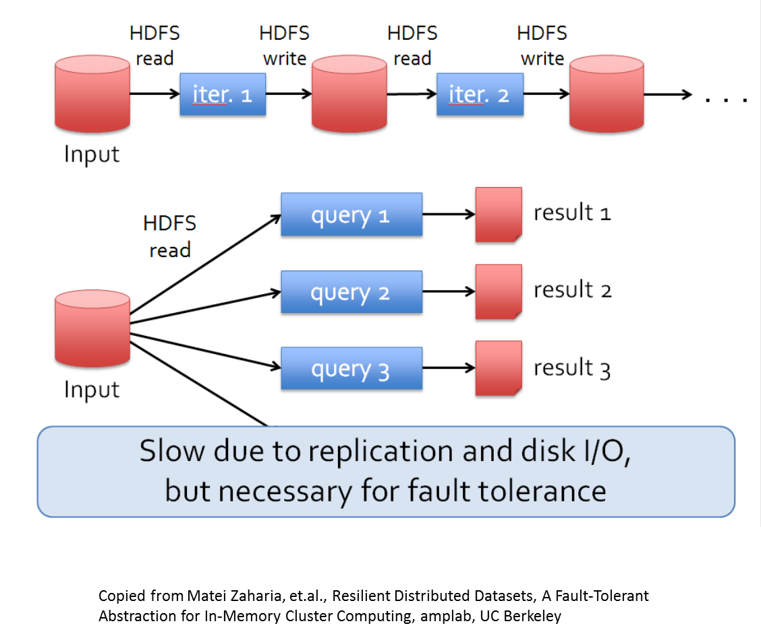

Slide 5
In other words, MapReduce lacks efficient primitives for data sharing
This is where Spark comes into the picture – instead of load the data from disk for every query, why not do In-Memory data sharing?

Slide 6
Here is how Spark addresses this issue: Resilient Distributed Datasets (RDDs)
RDD allows applications to keep working sets in memory for reuse.

Slide 7

RDD Overview
A new programming model (RDD)
  parallel/distributed computing
  in-memory sharing
  fault-tolerance
An implementation of RDD: Spark

Slide 8

Spark’s Philosophy
Generalize MapReduce
Richer Programming Model
  Fewer Systems to Master
Better Memory Management
  Less data movement leads to better performance for complex analytics

Slide 9
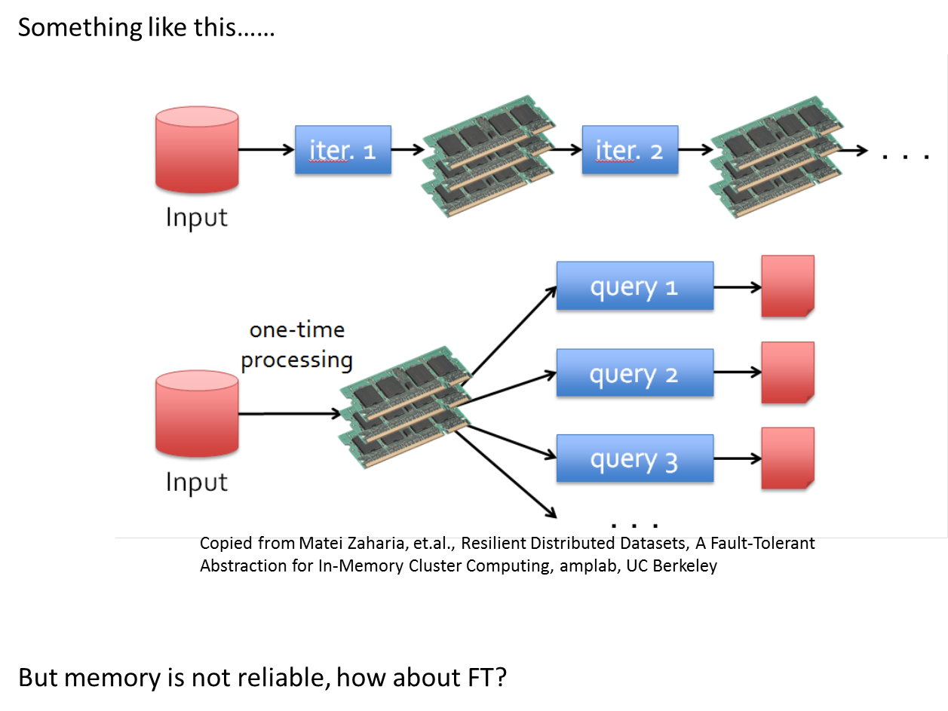

Slide 10
Spark’s solution: Resilient Distributed Datasets (RDDs)
  Read only, partitioned collections of objects
  A distributed immutable array
  Created through parallel transformations on data in stable storage
  Can be cached for efficient reuse.
Cited from Matei Zahria, Spark fast, interactive, language-integrated cluster computing, amplab, UC Berkeley

Slide 11
Log the operations that generates the RDD
Automatically rebuilt on (partial) failure

Slide 12
Spark API
Spark provides API to support the following languages: Scala, Java, Python, R
Data Operations
  Transformations; lazily create RDDs
  wc = dataset.flatMap(tokenize).reduceByKey(add)
  Actions; execute compilation
  wc.collect()

Slide 13
Abstraction: Dataflow Operators
map | reduce | sample
filter | count | take
groupBy | fold | first
sort | reduceByKey | partitionBy
union | groupByKey | mapWith
join | cogroup | pipe
leftOuterJoin rightouterjoin | Cross Zip | Save ...

Slide 14

Spark Example: Log Mining
Load error messages from a log into memory and run interactive queries
base RDD
lines = spark.textFile("hdfs://...")
errors = lines.filter(_.startsWith("ERROR"))
transformation
errors.persist()
errors.filter(_.contains("Foo")).count()
action!
errors.filter(_.contains("Bar")).count()
Master
Worker
Result: full-text search on 1TB data in 5-7sec vs. 170sec with on-disk data!
Worker

Slide 15
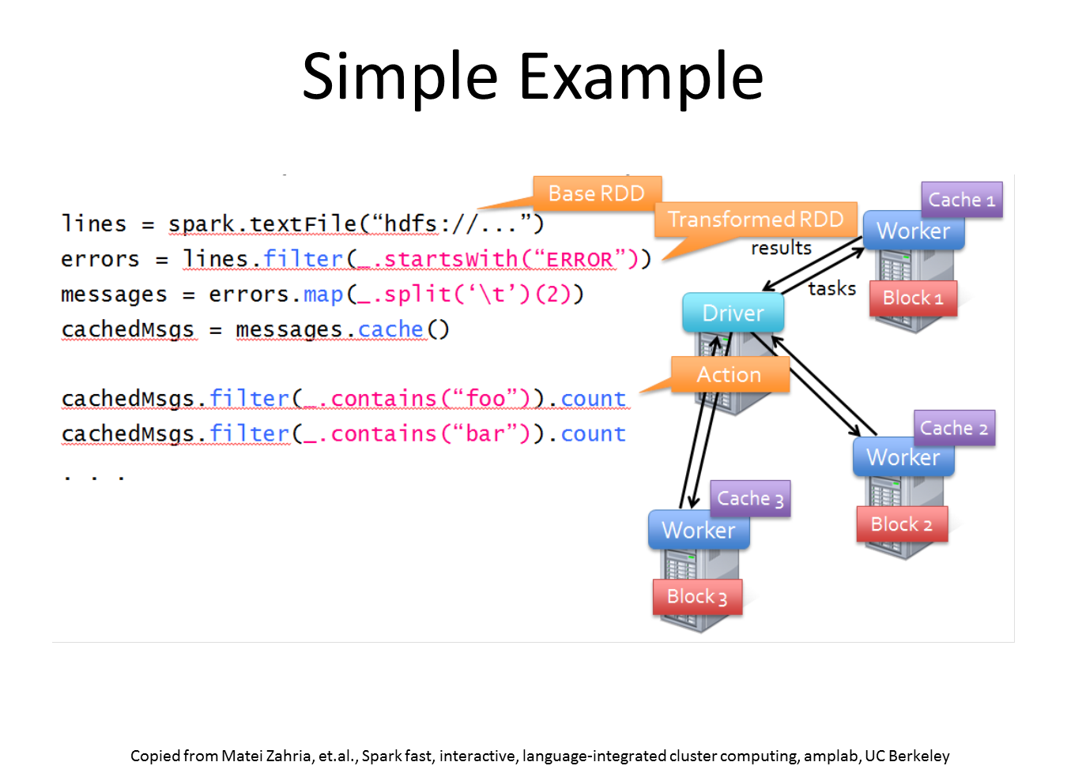

Slide 16
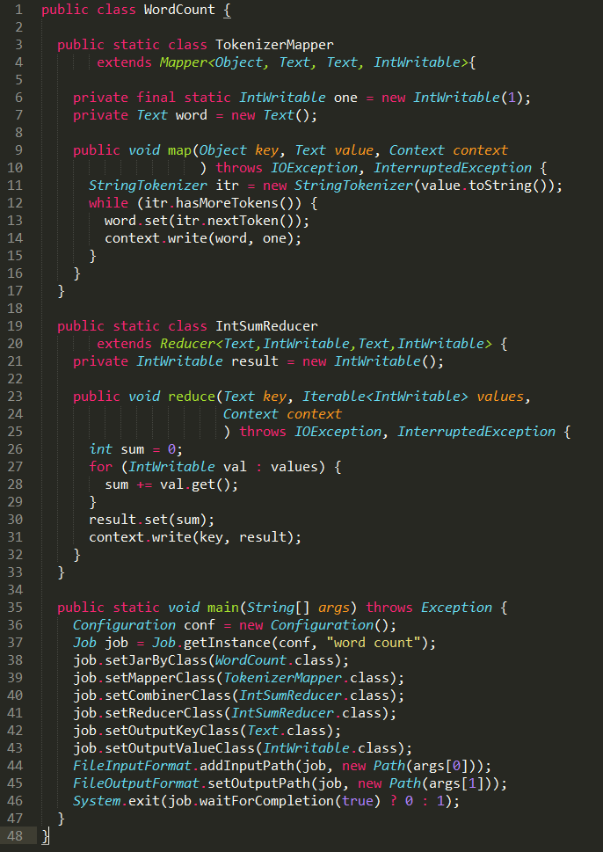

Simple Yet Powerful
WordCount Implementation: Hadoop vs. Spark
Pregel: iterative graph processing, 200 LoC using Spark
HaLoop: iterative MapReduce, 200 LoC using Spark

Slide 17
WordCount
val counts = sc.textFile(“hdfs://…”).flatMap(line=>line.split(“”)).map(word=>(word, 1L)).reduceByKey(_+_)

Slide 18
What is Iterative Algorithm?
  data = input data
  w = <target vector> -(Shared data structure)
  At each iteration,
  Do something to item in data:
  Update (w) -(Update shared data structure)

Slide 19
val data = spark.textFile(...).map(readPoint).cache()
var w = Vector.random(D)
for (i <- 1 to ITERATIONS) {
val gradient = data.map(p =>
(1 / (1 + exp(-p.y*(w dot p.x))) - 1) * p.y * p.x
).reduce(_ + _)
w -= gradient
}
println("Final w: " + w)
Copied from Matei Zahria, et.al., Spark fast, interactive, language-integrated cluster computing, amplab, UC Berkeley

Slide 20
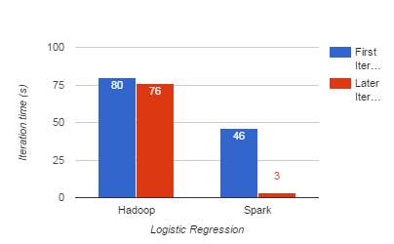
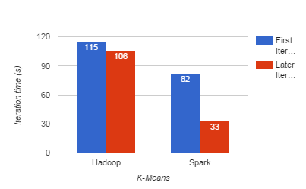
Evaluation
10 iterations on 100GB data using 25-100 machines
Notes:
Gain on first iteration: Hadoop heartbeat protocol between master and workers

Slide 21
Spark Ecosystem
Copied from Matei Zaharia Spark’s Role in the Big Data Ecosystem, Databricks

Slide 22
Spark Core: is the execution engine for the spark platform. It provides distributed in-memory computing capabilities
Spark SQL: is an engine for Hadoop Hive that enables unmodified Hadoop Hive queries to run up to 100x faster on existing deployments and data
Spark Streaming: is an engine that enables powerful interactive and analytical applications on streaming data
MLLib: is a scalable machine learning library
GraphX is a graph computation engine built on top of Spark

Slide 23
Hadoop Vs Spark
Spark is a computing framework that can be deployed upon Hadoop.
You can view Hadoop as an operating system for a distributed computing cluster, while Spark is an application running on the system to provide in-memory analytics functions.

Slide 24
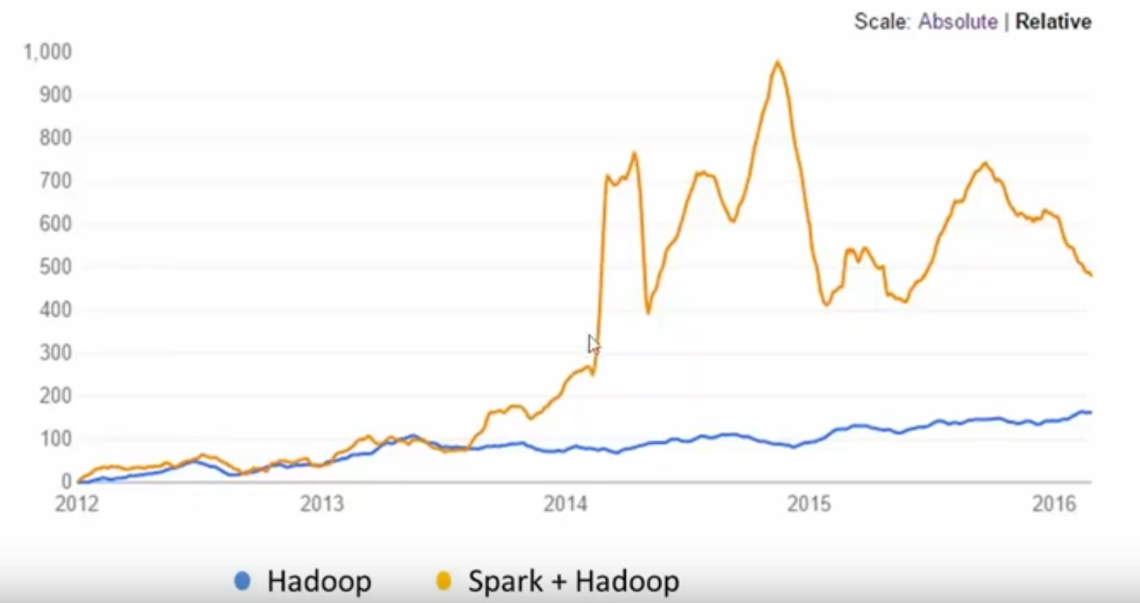

Slide 25


Slide 26


