Slide 1
Preprocessing the Data in Apache Spark

Slide 2
Steps in preprocessing
Deploy data to the cluster
Creating building RDD
Verifying the data thru. sampling
Cleaning data: For example
Converting the datatype
Filing missing values
Other steps: integration, reduction, transformation, discretization

Slide 3
The Data Set

Slide 4
Deploy the data to the cluster
Distributed computing requires the file distributed across the cluster
Transfer the local data files to hdfs
$ hdfs dfs –mkdir linkage
$ hdfs dfs –put block_*.csv linkage

Slide 5
Creating
Create a RDD (Resilient Distributed Dataset) from text file
val rawblocks = sc.textFile(“hdfs:///user/yxie2/linkage2”)
Create RDD from external databases
val hiveContext = new org.apache.spark.sql.hive.HiveContext(sc)
val test_enc_orc = hiveContext.sql("select * from test_enc_orc")
Spark is a lazy execution

Slide 6
Sampling data
Sample:
$val head = rawblocks.first()
$val top10 = rawblocks.take(10)
View data:
Printing on to client console
$head.foreach(println)

Slide 7
The Data Set

Slide 8
Pre-Process the data – Part II: Structuring Data with Tuples and Case Classes
The records in the head array are all strings of comma-separated fields
To make it a bit easier to analyze this data, we will need to parse these strings into a structured format that converts the different fields into the correct data type

Slide 9
def parse(line: String) ={
val pieces = line.split(‘,’)
val id1 = pieces(0).toInt
val id2 = pieces(1).toInt
val scores = pieces.slice(2,11).map(_.toDouble)
val matched = pieces(11).toBoolean
(id1, id2, scores, matched)
}
val lines= sc.textFile("hdfs://...")
val flines = lines.map(line => parse(line) )
Notes:
val line = head(5)
val pieaces = line.split(‘,’)
val id1 = pieces(0).toInt
val scores = pieces.slice(2,11).map(_.toDouble) //original toDouble method of SpringOps.

Slide 10
Needs to redefine the toDouble method
def toDouble(s: String) = {
if (“?”.equals(s)) Double.NaN else s.toDouble
}

Slide 11
def parse(line: String) ={
val pieces = line.split(‘,’)
val id1 = pieces(0).toInt
val id2 = pieces(1).toInt
val scores = pieces.slice(2,11).map(toDouble)
val matched = pieces(11).toBoolean
(id1, id2, scores, matched)
}
val flines = lines.map(line => parse(line) )
val filtered_data = flines.filter(tup => tup(4) > 0)

Slide 12
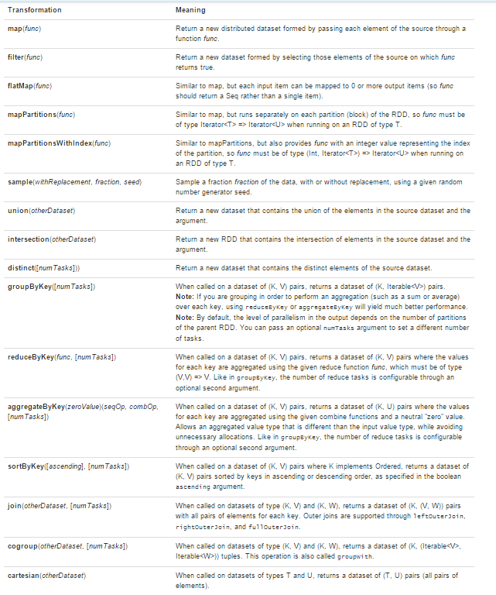
Transformation

Slide 13
Action

