Slide 1
Hadoop Basics

Slide 2
A brief history on Hadoop
2003 - Google launches project Nutch to handle billions of searches and indexing millions of web pages.
Oct 2003 - Google releases papers with GFS (Google File System)
Dec 2004 - Google releases papers with MapReduce
2005 - Nutch used GFS and MapReduce to perform operations
2006 - Yahoo! created Hadoop based on GFS and MapReduce (with Doug Cutting and team)
2007 - Yahoo started using Hadoop on a 1000 node cluster
Jan 2008 - Apache took over Hadoop
Jul 2008 - Tested a 4000 node cluster with Hadoop successfully
2009 - Hadoop successfully sorted a petabyte of data in less than 17 hours to handle billions of searches and indexing millions of web pages.
Dec 2011 - Hadoop releases version 1.0
Aug 2013 - Version 2.0.6 is available

Slide 3
Hadoop Ecosystem

Slide 4
The two major components of Hadoop
Hadoop Distributed File System (HDFS)
MapReduce Framework

Slide 5
HDFS
HDFS is a filesystem designed for storing very large files running on clusters of commodity hardware.
- Very large file: some hadoop clusters stores petabytes of data.
- Commodity hardware: Hadoop doesn’t require expensive, highly reliable harware to run on. It is designed to run on clusters of commodity hardware.

Slide 6
Blocks
- Files in HDFS are broken into block-sized chunks. Each chunk is stored in an independent unit.
- By default, the size of each block is 64 MB.

Slide 7
- Some benefits of splitting files into blocks.
-- a file can be larger than any single disk in the network.
-- Blocks fit well with replication for providing fault tolerance and availability. To insure against corrupted blocks and disk/machine failure, each block is replicated to a small number of physically separate machines.

Slide 8
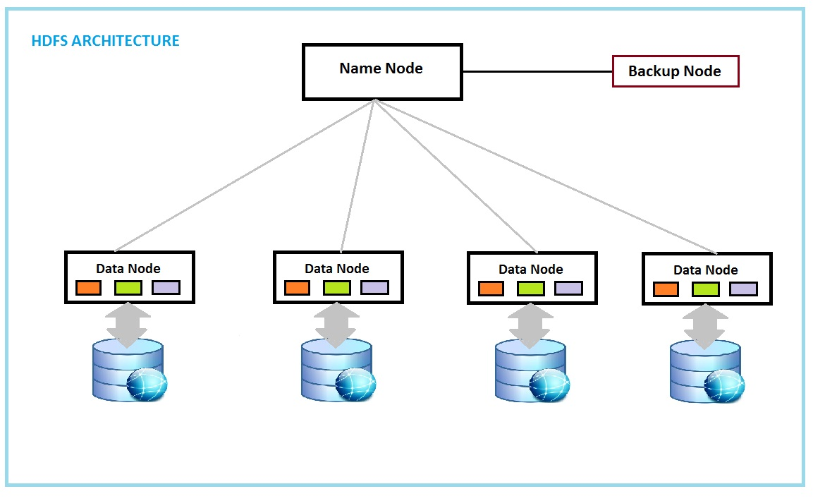

Slide 9
Namenodes
-- The namenode manages the filesystem namespace.
-- It maintains the filesystem tree and the metadata for all the files and directories.
-- It also contains the information on the locations of blocks for a given file.
Datanodes
- datanodes: stores blocks of files. They report back to the namenodes periodically

Slide 10
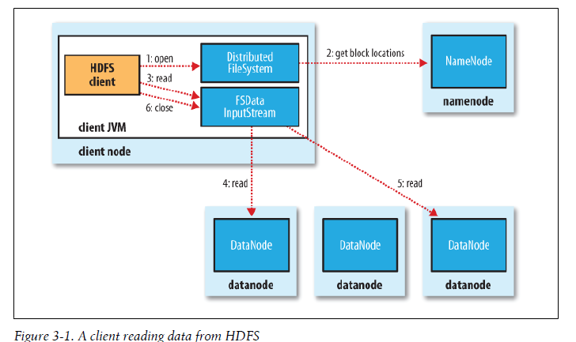

Slide 11
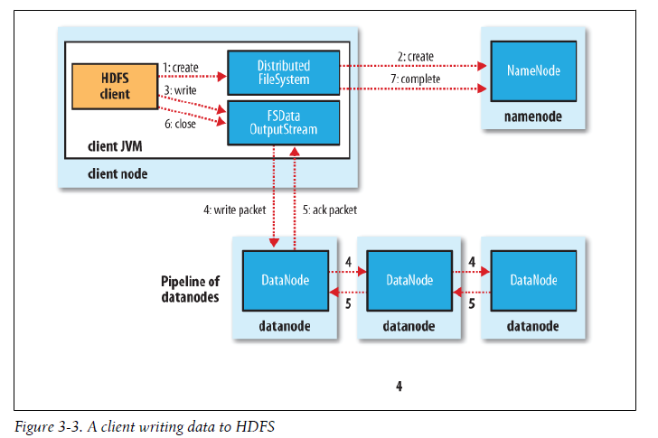

Slide 12
MapReduce Programming Model – Mappers and Reducers
In MapReduce, the programmer defines a mapper and a reducer with the following signatures:
Implicit between the map and reduce phases is shuffle, sort, and group-by operation on intermediate keys.
Output key-value pairs from each reducer are written persistently back onto the distributed file system.

Slide 13
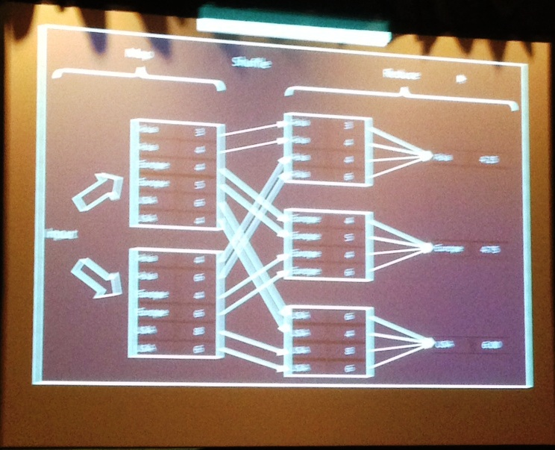
MapReduce Schematic

Slide 14
Word Count- Schematic
In Mappers Shuffle Reducers Out
Key freq Key freq key freq
Word1-Book1 n1 Word1-Book1 n1
Word1-Book2 n2 Word1-Book2 n2 Word1 n13
Book1 Word2-Book1 n3 Word1-Book3 n7
Book2 Word2-Book2 n4 Word1-Book4 n8
Word3-Book1 n5
Word3-Book2 n6 Word2-Book1 n3
Word2-Book2 n4 Word2 n14
Word2-Book3 n9
Word1-Book3 n7 Word2-Book4 n10
Word1-Book4 n8
Book3 Word2-Book3 n9
Book 4 Word2-Book4 n10 Word3-Book1 n5
Word3-Book3 n11 Word3-Book2 n6 Word3 n15
Word3-Book4 n12 Word3-Book3 n11
Word3-Book4 n12
Computation: n13 = (n1 + n1 + n7 + n8)
n14 = (n3 + n4 + n9 + n10)
n15 = (n5 + n6 + n11 + n12)

Slide 15
WordCount Example
Given the following file that contains four documents
#input file
1 Algorithm design with MapReduce
2 MapReduce Algorithm
3 MapReduce Algorithm Implementation
4 Hadoop Implementation of Hadoop
We would like to count the frequency of each unique word in this file.

Slide 17
Two blocks of the input file
Computing node 1: Invoke map function on each key value pair
Computing node 2: Invoke map function on each key value pair
#iblock 1
1 Algorithm design with MapReduce
2 MapReduce Algorithm
#iblock 2
1 MapReduce Algorithm implementattion
2 Hadoop implmentation of MapReduce
(algorithm, 1), (design, 1), (with, 1), (MapReduce, 1) (MapReduce, 1), (algorithm, 1), (implementation, 1)
(MapReduce, 1), (algorithm, 1) (Hadoop, 1), (implementation, 1), (of, 1), (MapReduce, 1)
Shuffle and Sort
(algorithm, [1, 1, 1]), (desgin, [1]), (with, [1]), (MapReduce, [1, 1, 1, 1]), (implementation, [1, 1]), (Hadoop, [1], (of, [1])
(implementation, [1, 1]), (MapReduce, [1, 1, 1, 1]), (of, [1]), (with, [1])
Computing node 4 – Reducer 2: : Invoke reduce function on each pair
(algorithm, [1, 1, 1]), (desgin, [1]), (Hadoop, [1])
Computing node 3 – Reducer 1: Invoke reduce function on each pair
(algorithm, 3), (design, 1), (Hadoop, 1)
(implementation, 2), (MapReduce, 4), (of, 1), (with, 1)

