Slide 1
Sentiment Analysis with PySpark
Satya Katragadda
March 22, 2018

Slide 2
Goal
Perform Sentiment Analysis with spark
TF-IDF
N-gram
Count Vectorizer
Logistic Regression

Slide 3
Import the Data

Slide 4
Import the Data -2

Slide 5
Training and Testing Sets

Slide 6
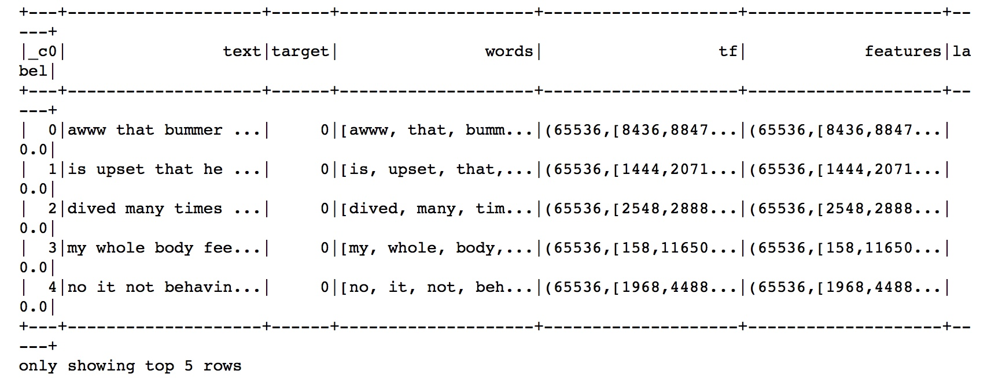
Hashing TF and IDF

Slide 7
Sentiment Analysis

Slide 8
Another way to compute TF

Slide 9
N-Gram Implementation

Slide 10
N-Gram Implementation

Slide 11
Questions: satya@Louisiana.edu
Acknowledgements:
https://github.com/tthustla/setiment_analysis_pyspark/blob/master/Sentiment%20Analysis%20with%20PySpark.ipynb

