Slide 1
Big Data Analytics: Technologies, Opportunities, and Challenges
Murali K. Pusala
Jan 11, 2018

Slide 2
CMPS 490 / CSCE 598
Big Data Analytics
Description: Essentials of Big Data analytics. Topics include: challenges and opportunities posed by Big Data in a variety of domains, predictive analytics or other advanced methods to extract value from data, innovative statistical techniques to glean insights from data, frameworks for parallelizing data pre-processing and data analytics, such as, Hadoop and Spark, and distributed algorithms to accelerate knowledge discovery.
  3 Credit(s). 0 Hour(s) Lab. 3 Hour(s) Lecture
  Prereq: Math 362 and CMPS 460(G) or permission of instructor required.

Slide 3
CMPS 490 / CSCE 598
Big Data Analytics
Title | Principles of Big Data: Preparing, Sharing, and Analyzing Complex Information
Publisher | Morgan Kaufmann Publishers Inc. San Francisco, CA, USA ©2013
ISBN | 9780124047242

Slide 4





Who is Generating Big Data?
Facebook : 1.39 billion monthly users
YouTube: 300hrs video uploaded/min
Instagram:70 Million photos/day
4.9 billion devices (2015)
ASKA Pathfinder: 36 antennas stream 250GB/sec/antenna
LHC at CERN:15 petabytes/year
Walmart: 1 million transactions each hour
Walmart holds 2.5 petabytes
ASKA: Australian Square Kilometer Array LHC: Large Hadron Collider CERN: European Organization for Nuclear Research

Slide 5
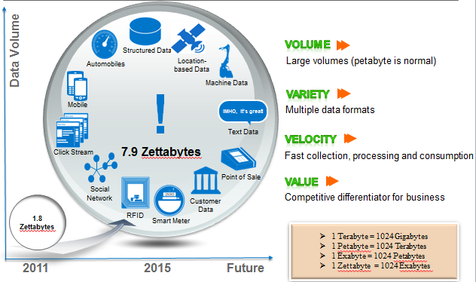
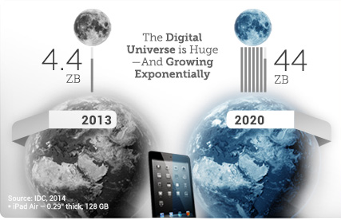
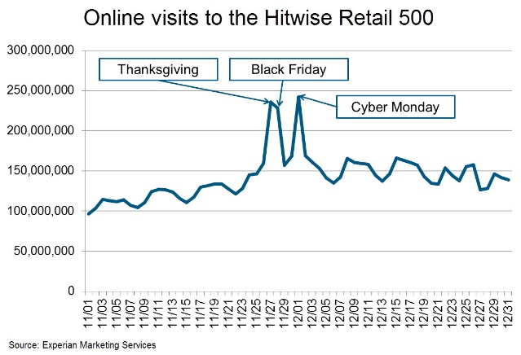
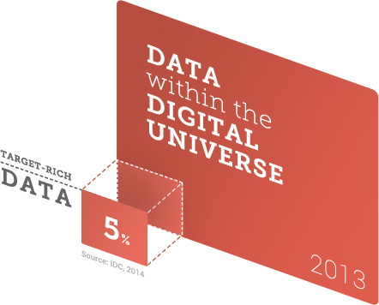
Big Data Overview
1 minute
2.5 million shares
300K tweets
220K photos Instagram
50K Apps AppStore
200 million emails
$80K amazon sales
Variety
Volume
Velocity
5 V
Variability
Veracity
Notes:
Volume:
Variety:
Data from variety of data sources, including structured, semi-structured, and unstructured data
Estimated that 85% of total organizational data are unstructured data
Almost all the data generated by individuals (e.g., emails, messages, blogs, and mul- timedia) are unstructured data too
Velocity:
Velocity of data is described as problem of handling and processing data at thespeeds at which they are generated to extract a meaningful value.
Example online retailers: There is a need to analyze customers’ visits within a reasonable timespan (e.g., real-time) to recommend similar items and related items
For instance, LHC at CERN [13] analyzes data, smart watches for location based updates/suggestions
Variability:
Data variability is the variation in data flow with time of day, season, events, etc.
For example, retailers sell significantly more in November and December compared to rest of year.
Veracity:
-The quality of collected data, to extract a value from, is referred as veracity. The
- Data generated in 2013 only 22% of data are tagged, or somehow characterized as useful data for analysis, and only 5% of data are considered valuable or “Target Rich” data.

Slide 6
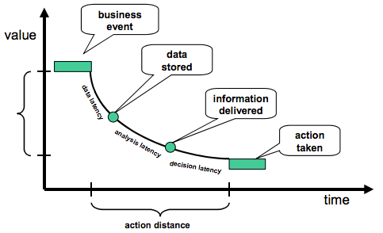
Velocity- Time to action vs. Value Hackathorn, 2002

Slide 7
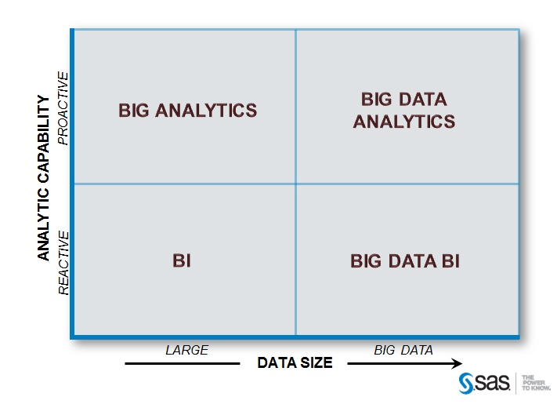
Kinds of Big Data Problems Davis, 2012

Slide 8
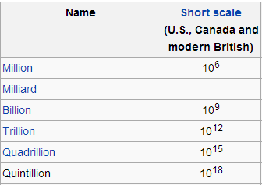
Source: wikipedia

Slide 9
The total amount of digital data will reach 180 zettabytes in 2025. Approximately 80 percent of this data will be unstructured…
Megabyte (1 000 000 Bytes)
Gigabyte (1 000 000 000 Bytes)
Terabyte (1 000 000 000 000 Bytes)
Petabyte (1 000 000 000 000 000 Bytes)
Exabyte (1 000 000 000 000 000 000 Bytes)
Zettabyte (1 000 000 000 000 000 000 000 Bytes)
Yottabyte (1 000 000 000 000 000 000 000 000 Bytes)

Slide 10
Opportunities
Analyzing Big Data helps in informed decision-making
Advantages of Big Data
  Understanding and targeting customers
  Understanding and optimizing business process
  Improve science and research
  Improving healthcare
  Optimizing machine and device performance

Slide 11
Applications
  Southwest analyses sensor data on their planes in order to identify patterns that indicate a potential malfunction or safety issue
  Oil and Gas exploration industries optimize drilling process by using earth’s sedimentation characteristics, temperature, pressure, soil type, depth, chemical composition, molecular structures, seismic activity, machine data
  Aurora Health care Center saved $6 Million by using analysis on patient’s history, allergies, medications, environmental conditions, etc.,
  Predictive analysis also helps to change price dynamically to attract consumers and maximize profits

Slide 12
Challenges
Processing Data
  Processing data at speed it’s been generated
Storing Data
  Scalable, Reliable and Faster storage
Interpreting Data
  Understanding Heterogonous and untagged data
Privacy and Security

Slide 13
Types of Big Data Analytics Pusala, 2016

Slide 14
Big Data Analytics Platforms
Big Data Analytics Platforms
  MapReduce
  Apache Hadoop
  Apache Spark
Data Management Systems for Big Data Analytics
  Hadoop Distributed File System
  NoSQL Databases
  Graph Databases

Slide 15
What is Data Science
Just having platforms and big data are not enough, we need to have “Data Science” to fill the gap between platforms and data.

Slide 16
Data science employs techniques and theories drawn from many fields such as statistics and machine learning to extract knowledge and insights from big data by leveraging big data platform

Slide 17
Turing award winner Jim Gray imagined data science as a "fourth paradigm" of science (empirical, theoretical, computational and now data-driven) and asserted that "everything about science is changing because of the impact of information technology and the data deluge”.

Slide 18
How is Big Data Related to Me?
There will be a shortage of talent necessary for organizations to take advantage of big data. By 2018, the United States alone could face a shortage of 140,000 to 190,000 people with deep analytical skills as well as 1.5 million managers and analysts with the know-how to use the analysis of big data to make effective decisions. (Source: McKinsey Global Institute; Big data: The next frontier for innovation, competition, and productivity)

Slide 19


Slide 20
References:
Davis, J. (2012). What Kind of Big Data Problem Do You Have? SAS Blogs Home. Retrieved December 16, 2012, from http://blogs.sas.com/content/corneroffice/2012/10/08/what-kind-of-big-data-problem-do-you-have/
M. K. Pusala, M. Amini Salehi, J. R. Katukuri, Y. Xie, and V. Raghavan, “Massive Data Analysis: Tasks, Tools, Applications, and Challenges BT - Big Data Analytics: Methods and Applications,” S. Pyne, B. L. S. P. Rao, and S. B. Rao, Eds. New Delhi: Springer India, 2016, pp. 11–40.
Hackathorn, R. (2002). Current practices in active data warehousing. available: http://www.dmreview.com/whitepaper/WID489.pdf

Slide 21
Thank You
Q&A

